Slide 1
Adversarial Multi-Criteria Learning for Chinese Word Segmentation
Xinchi Chen, Zhan Shi, Xipeng Qiu, Xuanjing Huang
(one of ACL 2017 outstanding papers)

Slide 2
Overview
Task: Chinese Word Segmentation (CWS)
General idea: adversarial multi-criteria learning (by integrating shared knowledge from multiple segmentation criteria)
Model: shared-private feature layer (three different connections) + CRF inference layer + adversarial training for shared layer
Experiments: basic experiments of three models + knowledge transfer experiments

Slide 3
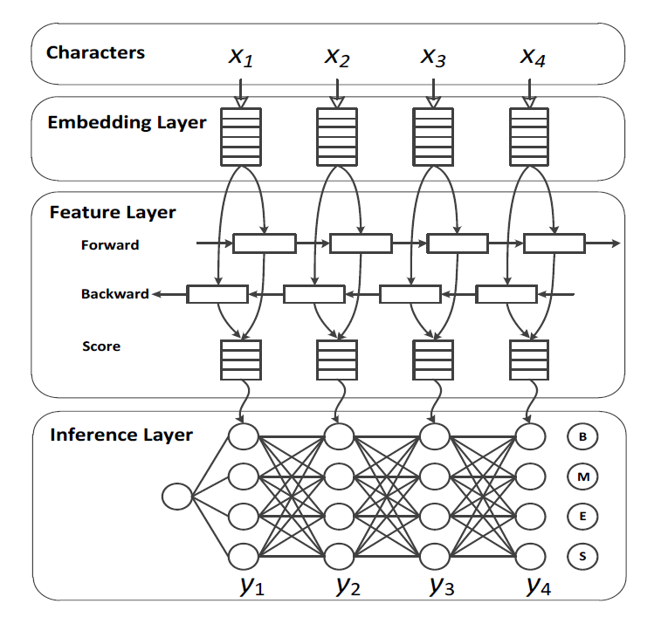
General Architecture

Slide 4




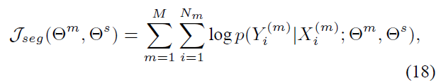

General Architecture
Score function:
CRF layer:
Objective function:
$Θ^{m}and Θ^{s} \text{denotes} \text{parameters} \text{in} \text{private} \text{and} \text{shared} \text{layers}$.

Slide 5
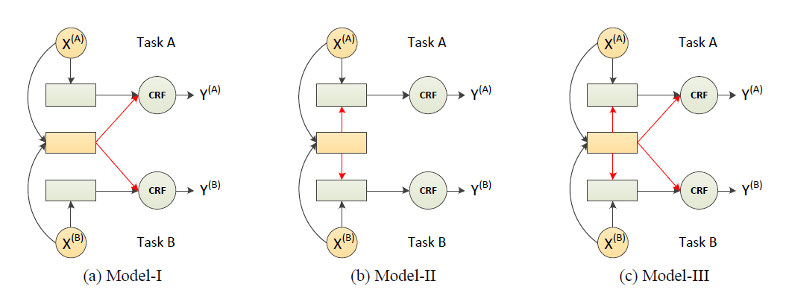
Multi-Criteria Learning

Slide 6
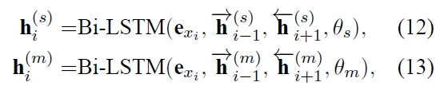
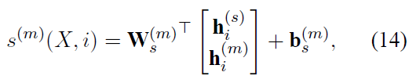
Multi-Criteria Learning
Model-I: parallel model

Slide 7
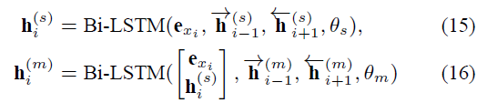

Multi-Criteria Learning
Model-II: stacked model

Slide 8
Multi-Criteria Learning
Model-III: skip-layer model

Slide 9
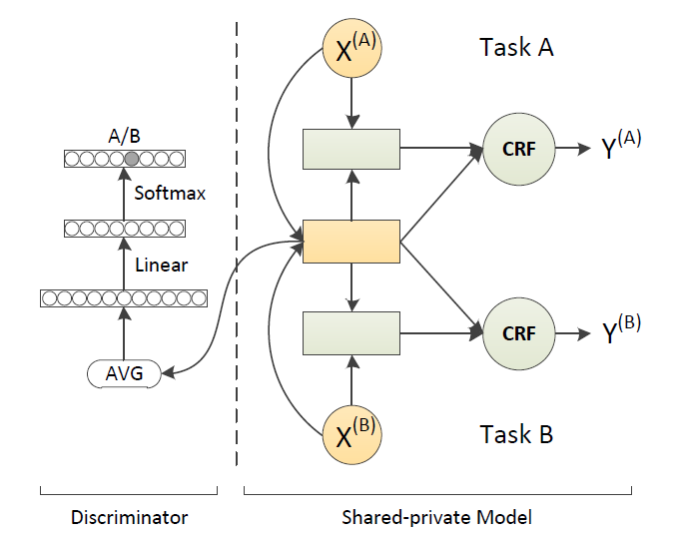

Adversarial Training

Slide 10

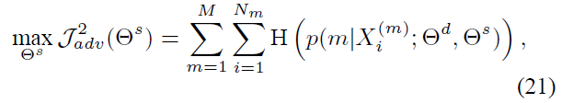

Adversarial Training
Adversarial objective function:
Final objective function:
for discriminator
for shared parameters
λ is the weight that controls the interaction of the loss terms.

Slide 11
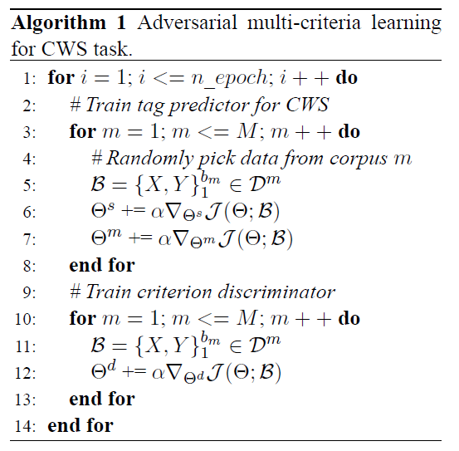
Adversarial Training

Slide 12
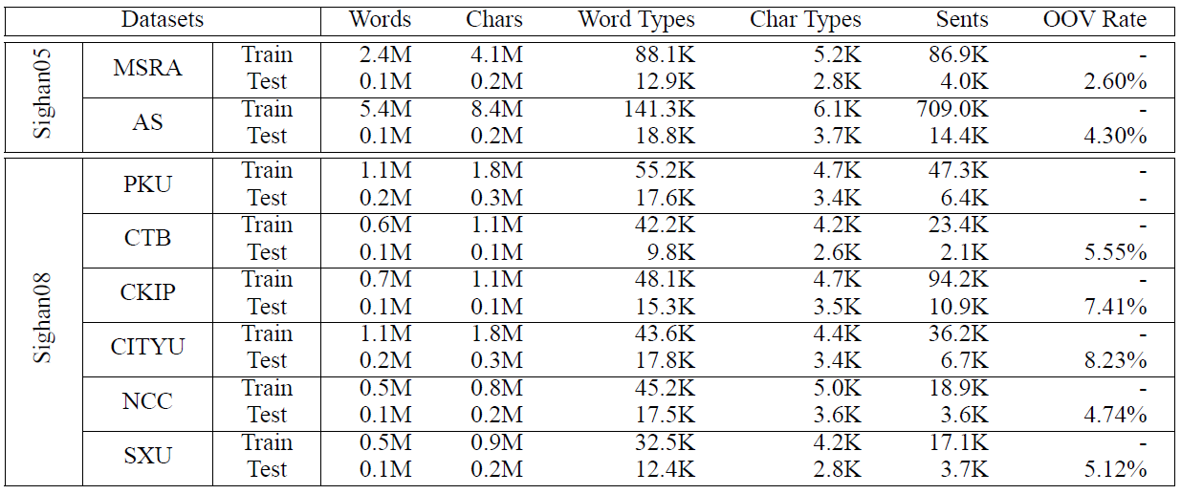
Experiments-models
Datasets:
eight datasets from SIGHAN2005 and SIGHAN2008

Slide 13
Settings
Hyperparameters
embedding size | 100
embedding layer dropout rate | 0.2
LSTM hidden state dimension | 100
initial learning rate | 0.01
λ | 0.05
optimizer | Adam

Slide 14


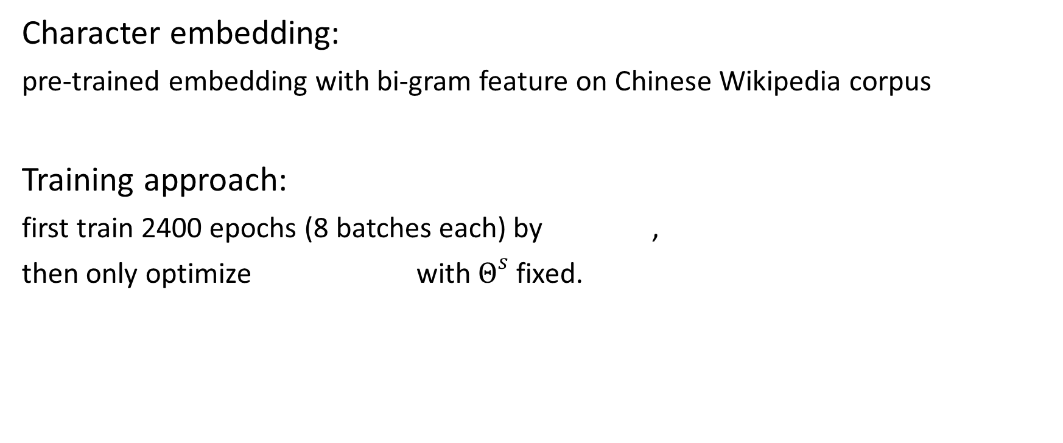
Settings
Character embedding:
pre-trained embedding with bi-gram feature on Chinese Wikipedia corpus
Training approach:
first train 2400 epochs (8 batches each) by ,
then only optimize with $Θ^{s}$ fixed.

Slide 15
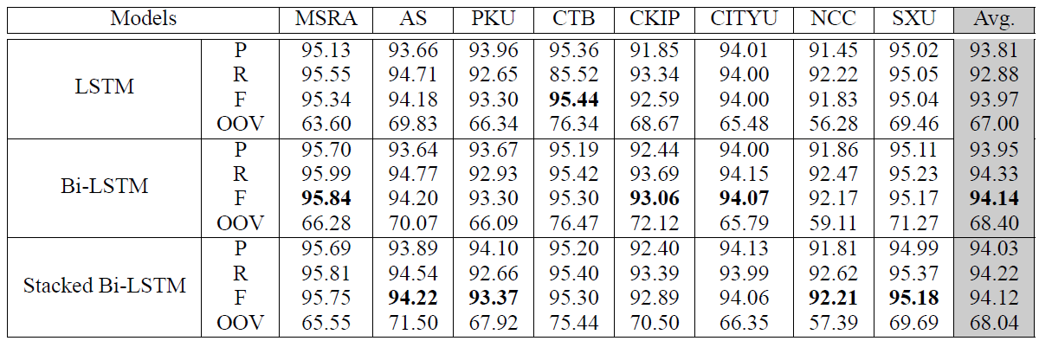
Experiments-models
Notes:
The performance is boosted by using Bi-LSTM, and
the performance of Bi-LSTM cannot be improved by merely increasing the depth of networks.

Slide 16
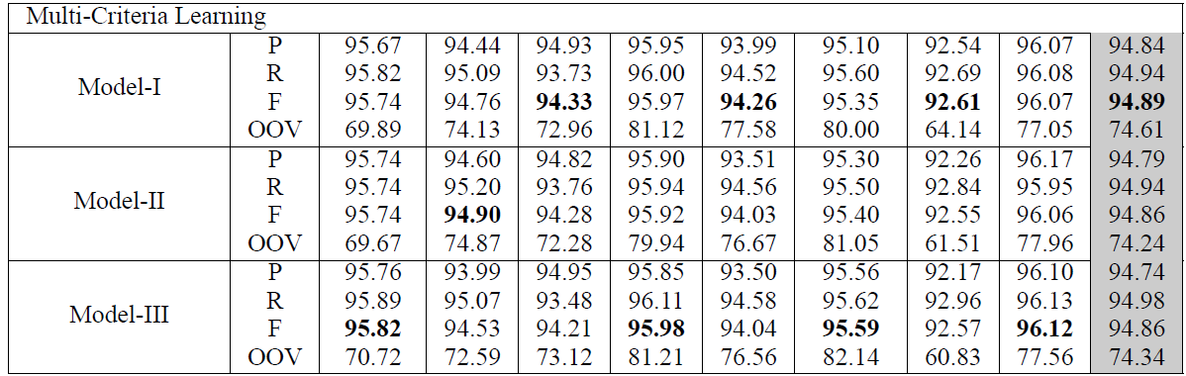
Experiments-models
Notes:
Compared to the baseline results (Bi-LSTM and stacked Bi-LSTM), the proposed models boost the performance
with the help of exploiting information across these heterogeneous segmentation criteria.

Slide 17
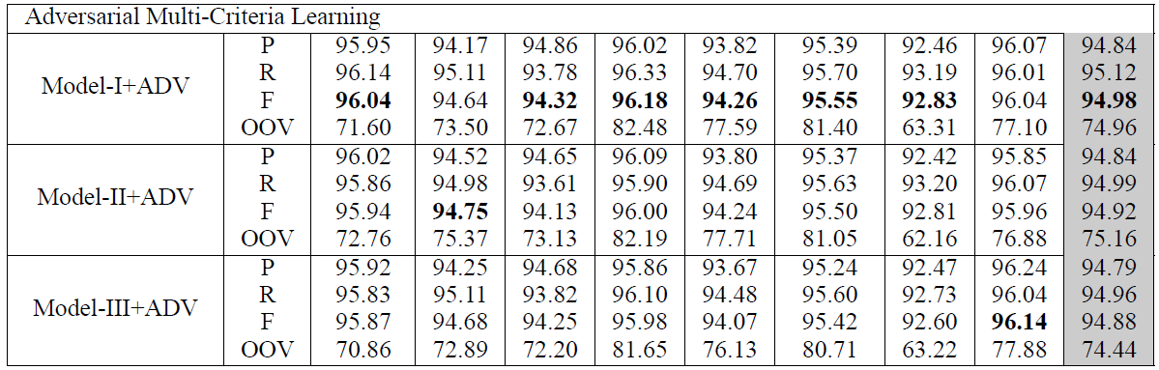
Experiments-models
Notes:
By introducing adversarial training, the performances are further boosted, and Model-I is slightly better than Model-II and Model-III.

Slide 18
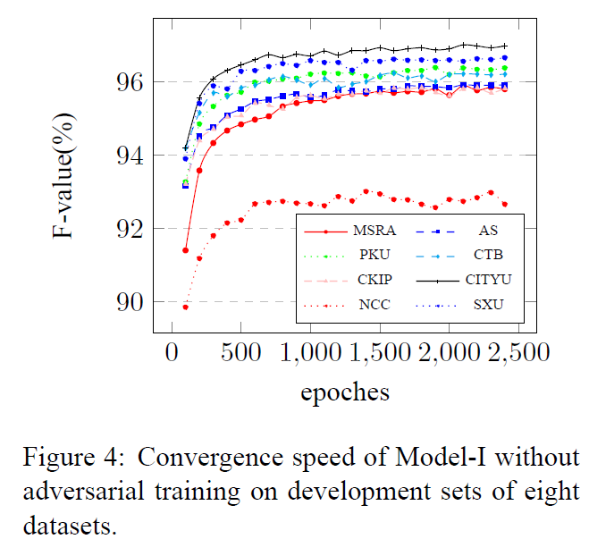
Experiments-models
For the models without adversarial training, it costs about 10 hours for training, whereas it takes about 16 hours for the models with adversarial training.

Slide 19
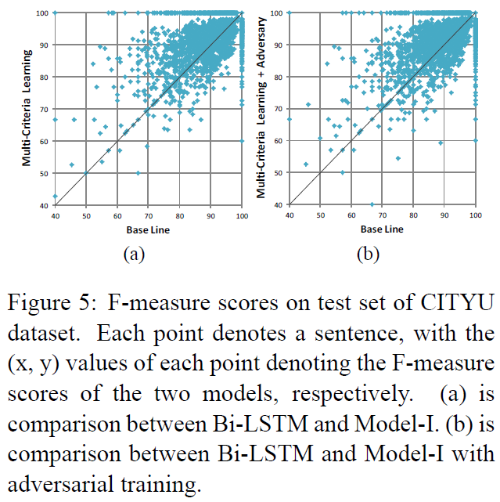
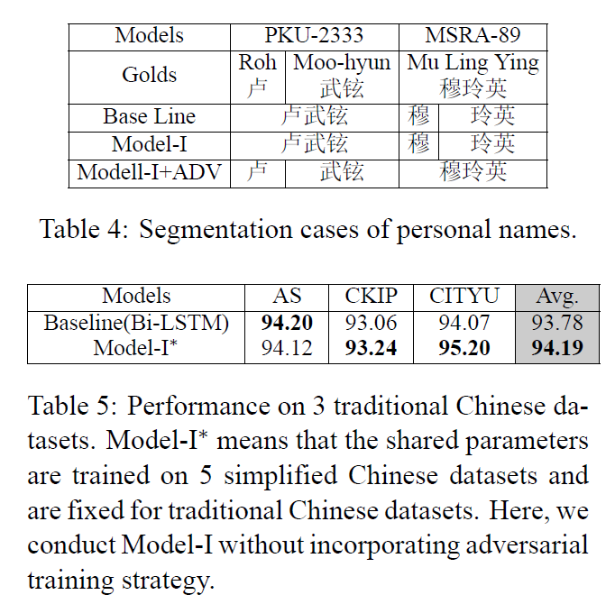
Experiments-models
Notes:
According to the results, we could observe that a large proportion of points lie above diagonal lines in Figure 5a and Figure 5b, which implies that performance benefit from integrating knowledge and complementary information from other corpora.

Slide 20
Experiments-knowledge transfer
Simplified Chinese to Traditional Chinese

Slide 21
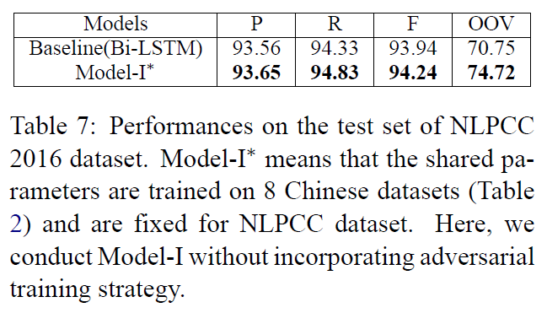
Experiments-knowledge transfer
Formal Texts to Informal Texts

Slide 22
Thanks for Listening!
Any Question?

